Slide 1
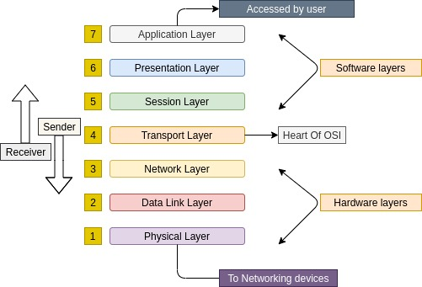
Transport Layer
Chapter 6
In the OSI layer model, the Lower layer provides services to the upper layer

Slide 2
Transport Layer
Transport layer is a process-to-process communication layer that is responsible for delivering the entire message.
A process is an application running on the host system. For process-to-process communication, the transport layer uses a port number assigned to each process uniquely.

Slide 3
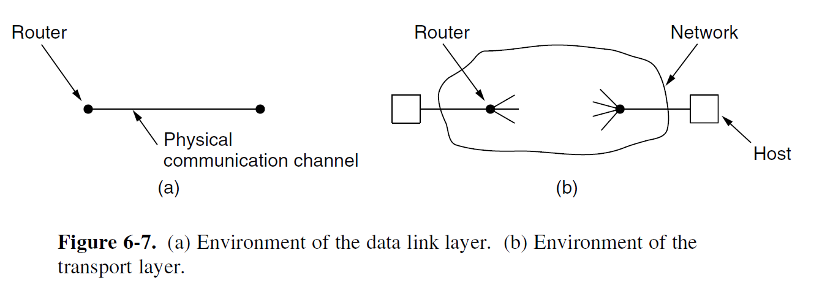
Data Link vs Transport Layer
Process to process
Point to point

Slide 4
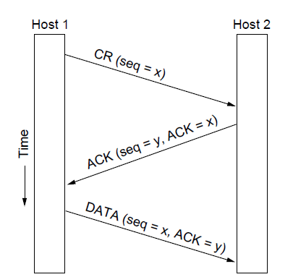
Connection Establishment
Three protocol scenarios for establishing a connection using a
three-way handshake. CR denotes CONNECTION REQUEST. Normal operation.

Slide 5
Connection Establishment
Establishing a connection sounds easy, but it is actually surprisingly tricky.
The problem occurs when the network can lose, delay, corrupt, and duplicate packets.
Only the common cases need be implemented efficiently to obtain good network performance, but the protocol must be able to cope with the uncommon cases without breaking.
It’s not necessary to perform well for uncommon cases.
It’s enough, if the protocol is able to cope with it without breaking.

Slide 6
Connection Establishment
The crux of the problem is that the delayed duplicates are thought to be new packets.
We cannot prevent packets from being duplicated and delayed. But if and when this happens, the packets must be rejected as duplicates and not processed as fresh packets.
The problem can be addressed in various ways, none of them very satisfactory.
Finally to solve this specific problem, Tomlinson (1975) introduced the three-way handshake.

Slide 7
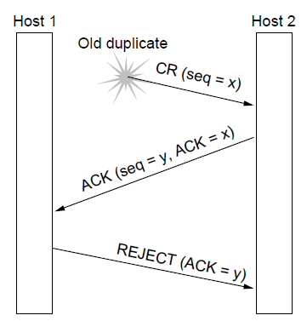
Connection Establishment
Three protocol scenarios for establishing a connection using a
three-way handshake. CR denotes CONNECTION REQUEST.
Old duplicate CONNECTION REQUEST appearing out of nowhere.

Slide 8
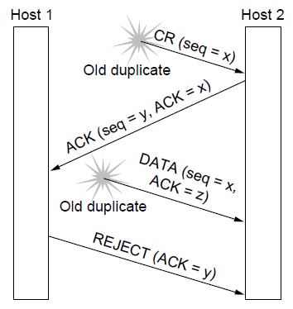

Connection Establishment
Expected ACK=y.
When the second delayed segment arrives at host 2, the fact that z has been acknowledged rather than y tells host 2 that this is an old duplicate.
The important thing to realize here is that there is no combination of old segments that can cause the protocol to fail and have a connection set up by accident when no one wants it.

Slide 9

Connection Establishment

Slide 10
Connection Release
There are two styles of terminating a connection:
Asymmetric release and
symmetric release.
Asymmetric release is the way the telephone system works: when one party hangs up, the connection is broken.
Asymmetric release is abrupt and may result in data loss.
Symmetric release treats the connection as two separate unidirectional connections and requires each one to be released separately.
Each direction is released independently of the other one.
Here, a host can continue to receive data even after it has sent a DISCONNECT segment.

Slide 11
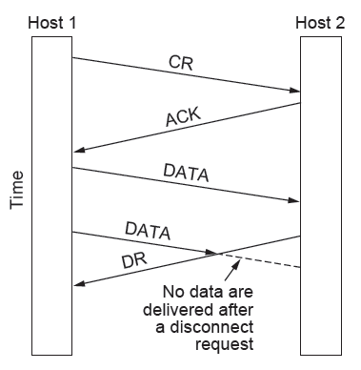
Connection Release
Asymmetric release
Abrupt disconnection with loss of data

Slide 12
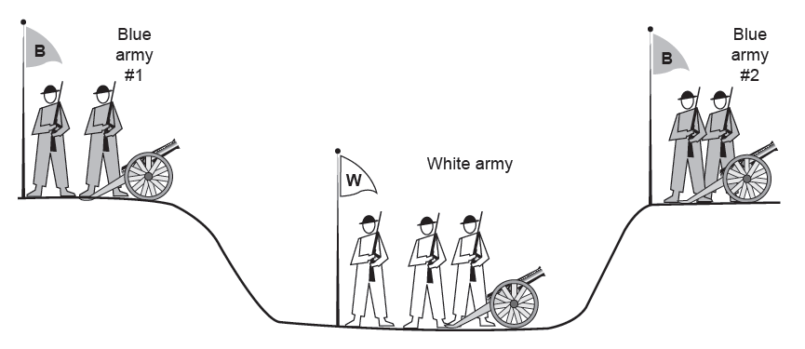

Connection Release
Symmetric release
Two blue armies want to synchronize their attacks to defeat White army.
The question is: does a protocol exist that allows the blue armies to win?
Will the attack happen?
‘‘I propose we attack at dawn on March 29. How about it?’’
‘‘I Agree”
-Blue Army 2
The two-army problem

Slide 13
Connection Release
Symmetric release
The question is: does a protocol exist that allows the blue armies to win?
Will the attack happen?
let us improve the protocol by making it a three-way handshake. Assuming no messages are lost, blue army #2 will get the acknowledgement.
But the commander of blue army #1 will now hesitate.
After all, he does not know if his acknowledgement got through, and if it did not, he knows that blue army #2 will not attack.
Did my ack get through?
ACK(‘‘I Agree”
-Blue Army 2)
The two-army problem

Slide 14
Connection Release
Symmetric release
The question is: does a protocol exist that allows the blue armies to win?
Will the attack happen?
We could now make a four-way handshake protocol, but that does not help either.
In fact, it can be proven that no protocol exists that works.
Did my ack get through?
ACK(ACK(‘‘I Agree”
-Blue Army 2))
Since the sender of the final message can never be sure of its arrival, he will not risk attacking.

Slide 15
Connection Release
Symmetric release
To see the relevance of the two-army problem to releasing connections, rather than to military affairs, just substitute ‘‘disconnect’’ for ‘‘attack.
If neither side is prepared to disconnect until it is convinced that the other side is prepared to disconnect too, the disconnection will never happen.
So if there is dependency disconnection will never happen.
We can avoid this quandary by
Foregoing the need for agreement and
Pushing the problem up to the transport user, letting each side independently decide when it is done.

Slide 16
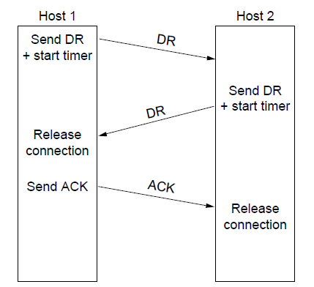
Connection Release
Scenarios for releasing a connection.
(a) Normal case of three-way handshake

Slide 17
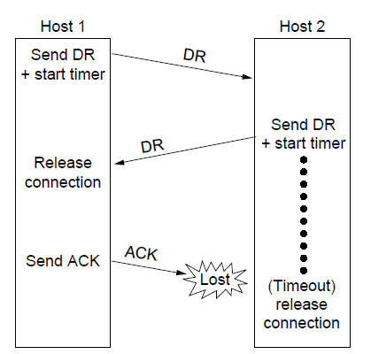
Connection Release
Final ACK lost:
The situation is saved by the timer.
When the timer expires, the connection is released anyway.
Scenarios for releasing a connection. (b) Final ACK lost.

Slide 18
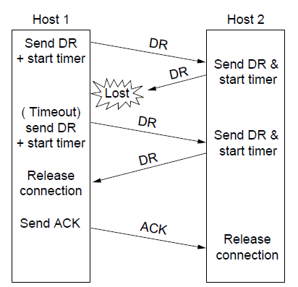

Connection Release
Second DR being lost:
The user initiating the disconnection will not receive the expected response, will time out, and will start all over again.
Scenarios for releasing a connection. (c) Response lost

Slide 19
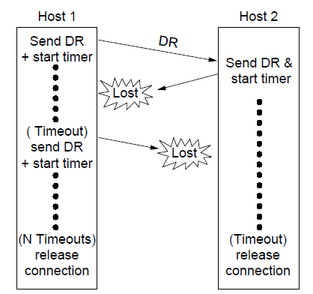
Connection Release
Response lost and subsequent DRs lost:
This is the same as Fig (c) except that now we assume all the repeated attempts to retransmit the DR also fail due to lost segments.
After N retries, the sender just gives up and releases the connection.
Meanwhile, the receiver times out and also exits.
Scenarios for releasing a connection. (d) Response lost and subsequent DRs lost.

Slide 20
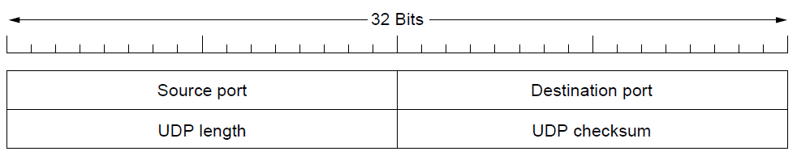
Introduction to UDP (1)
The UDP header.

Slide 21
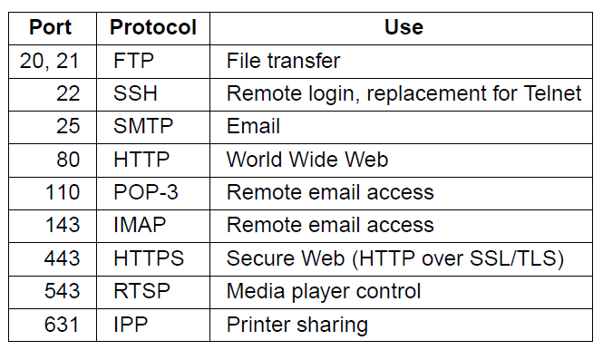
The TCP Service Model
Some assigned ports

Slide 22
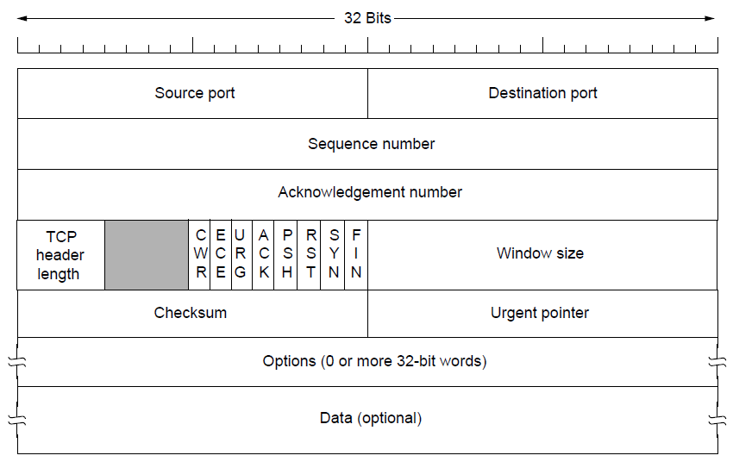
The TCP Segment Header
The TCP header.

Slide 23
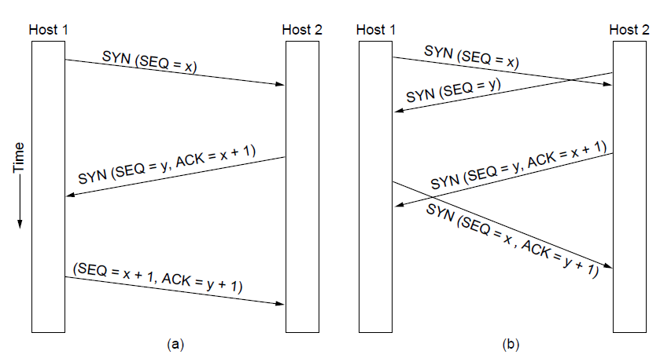
TCP Connection Establishment
TCP connection establishment in the normal case.
Simultaneous connection establishment on both sides.

